Slide 1

IACSD AKURDI
“ONLINE BOOK STORE
(bookstack.com)”
PG-DAC MARCH 2023
Submitted By:
Group No: 71
Ganesh Gaikhe (223153) Dhanraj Chavan (223150)
Guided By :
Mrs. Manjiri Deshpande

Slide 2
CONTENTS
Introduction
Problem statement
Technologies used
Database
Backend
Frontend
References

Slide 3
Introduction
Welcome to the Online Bookstore project, a web-based application built on Spring Boot, ReactJS, and MySQL.
This project aims to provide an intuitive and user-friendly online platform for customers to browse, purchase, and review books. To develop an electronic Ecommerce platform that allows users to purchase Books online.
To provide an easy-to-use interface for users to browse and purchase Books. With a focus on optimizing purchasing, selling, and overall operations, our project combines cutting-edge technology and streamlined processes to enhance the efficiency and effectiveness of bookstore management.
It also providing the necessary functionalities for admin and delivery personnel.

Slide 4
Problem Statement
Physical appearance
Time consuming
limited selections / accessibility
lack of personalized recommendations

Slide 5
Technologies Used
The objective is to create a web site that can perform the following:-
1)Backend → Spring Boot(Rest API)
2)Frontend → React JS
3)Database → MySQL(Spring JPA)
4)Server → Embedded Tomcat Server

Slide 6
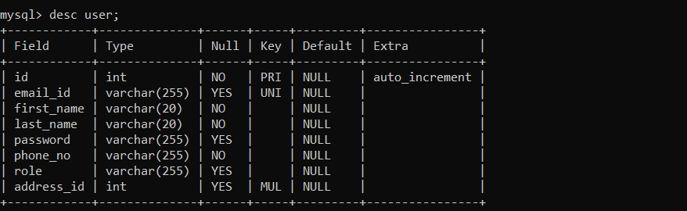
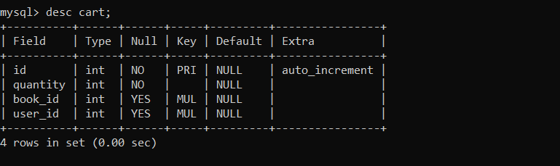
Database
1.User Table 2.Cart Table

Slide 7
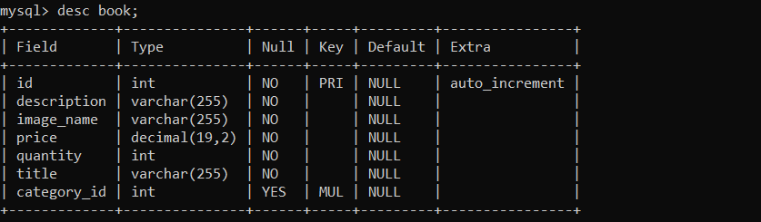
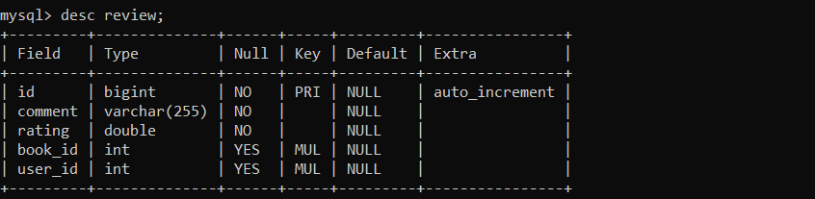
3.Book TABLE 4.Review TABLE

Slide 8
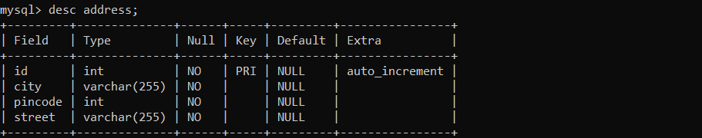
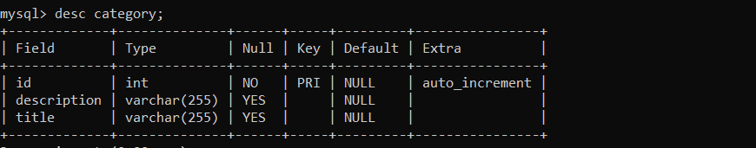
5.Address TABLE 6.Category TABLE

Slide 9
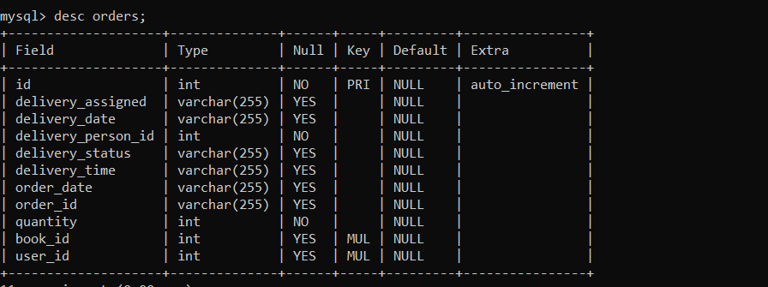
7.Orders TABLE

Slide 10
Backend
Entity : Variable defining and dataset method and override ( override the string method and give output in string format).
DAO(Data access object) : data access through query, Dao is a repository (JPA : java persistence API)
DTOS(data transfer /transaction object) : storing the data from frontend and store in the database
Service : services we can used for CRUD operation, service layer used repository(DAO/DTOS) to perform the CURD operation. Also called as business logic.
Controller : controller accept request from user go to the service layer and work on the request which is sent by user.

Slide 11
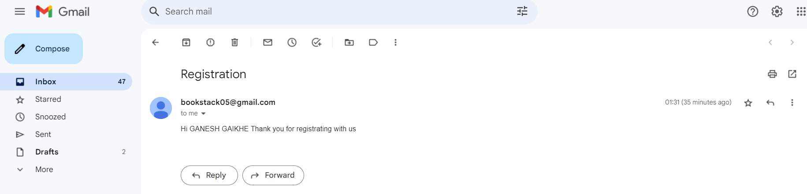
Email Functionality

Slide 12
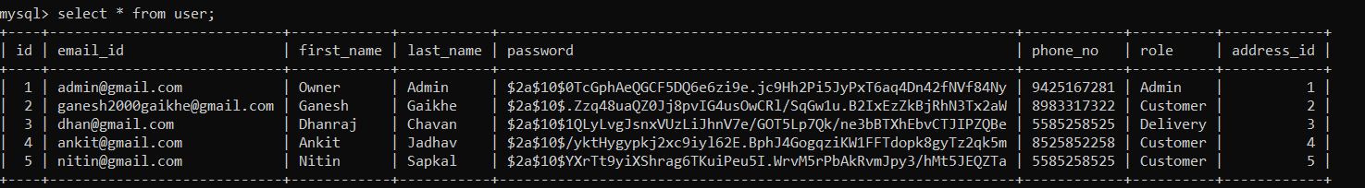
Password Encryption

Slide 13
Frontend
React is a JavaScript library for building user interfaces, and it can be used for a wide range of web development tasks.
Index.html : In a React web application, the index.html file serves as the main entry point or template for your application.
App.js :In a React application, the App.js file is typically the main or root component of your application. It's the starting point of your React application's component tree.

Slide 14
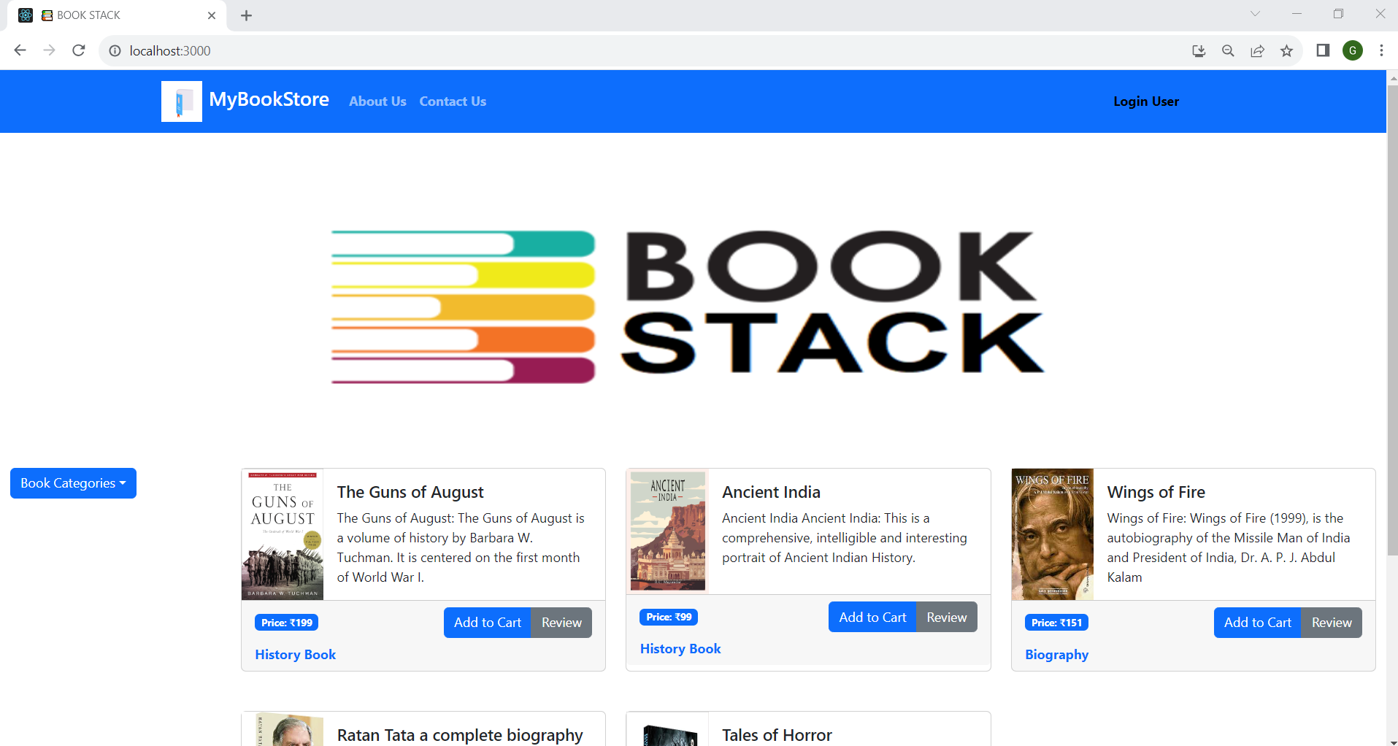
Homepage For Any User

Slide 15
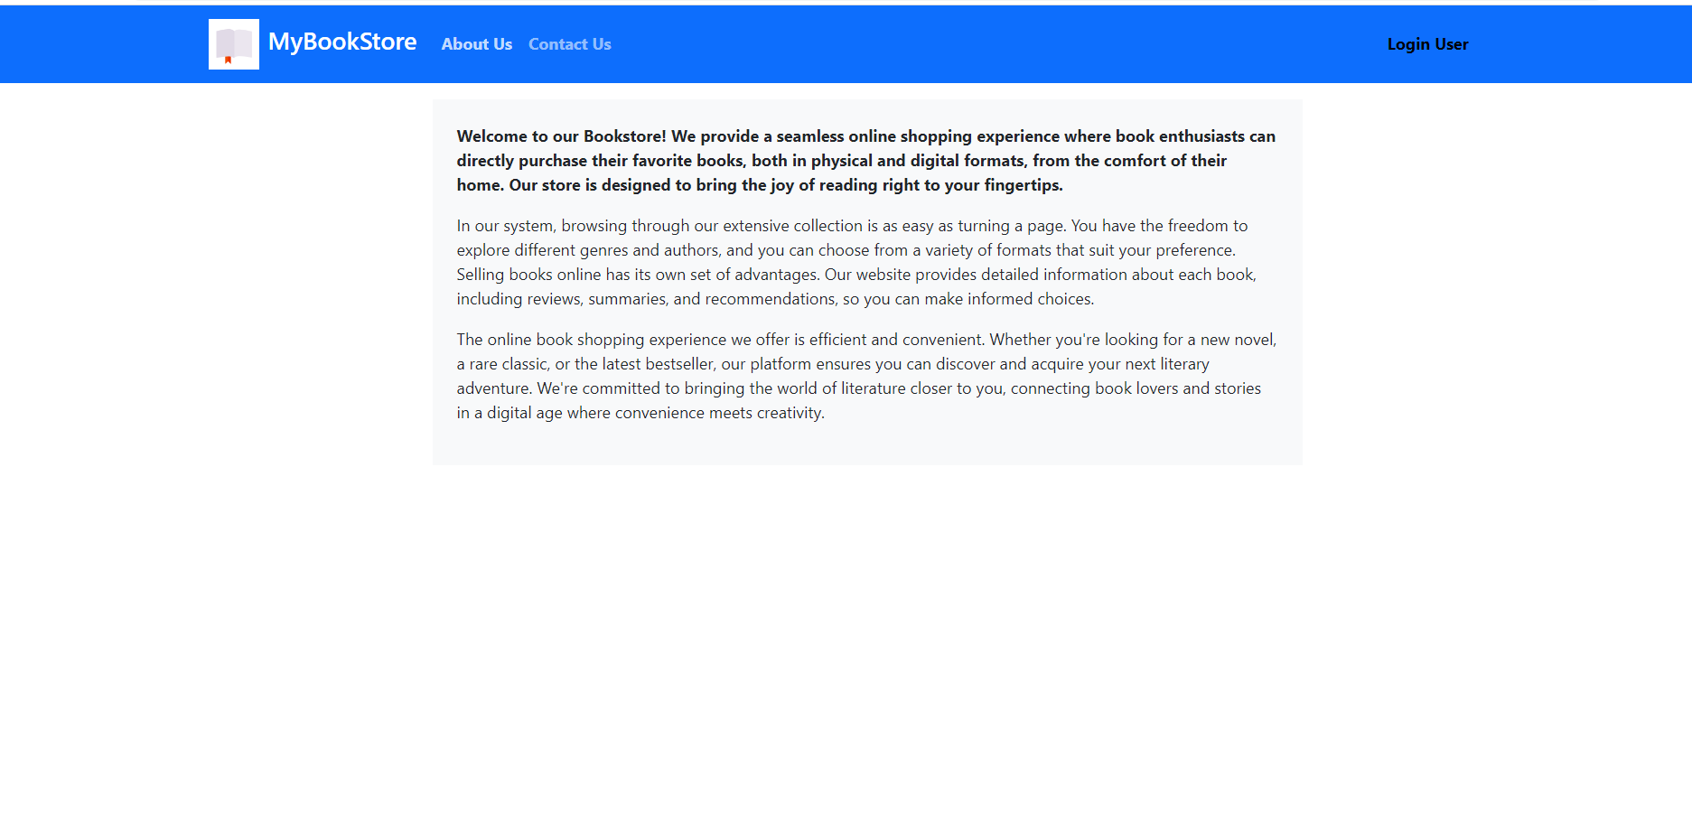
About Us Page

Slide 16
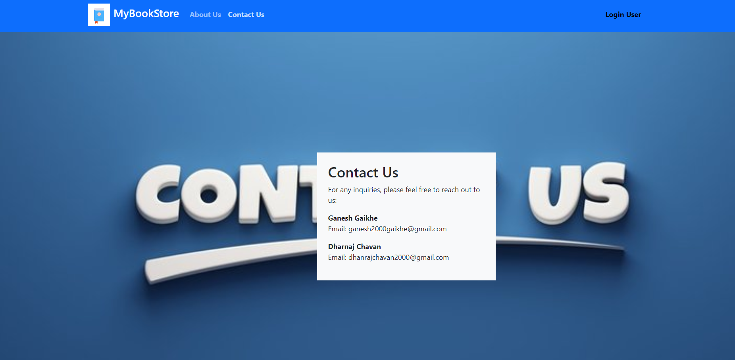
Contact Us

Slide 17
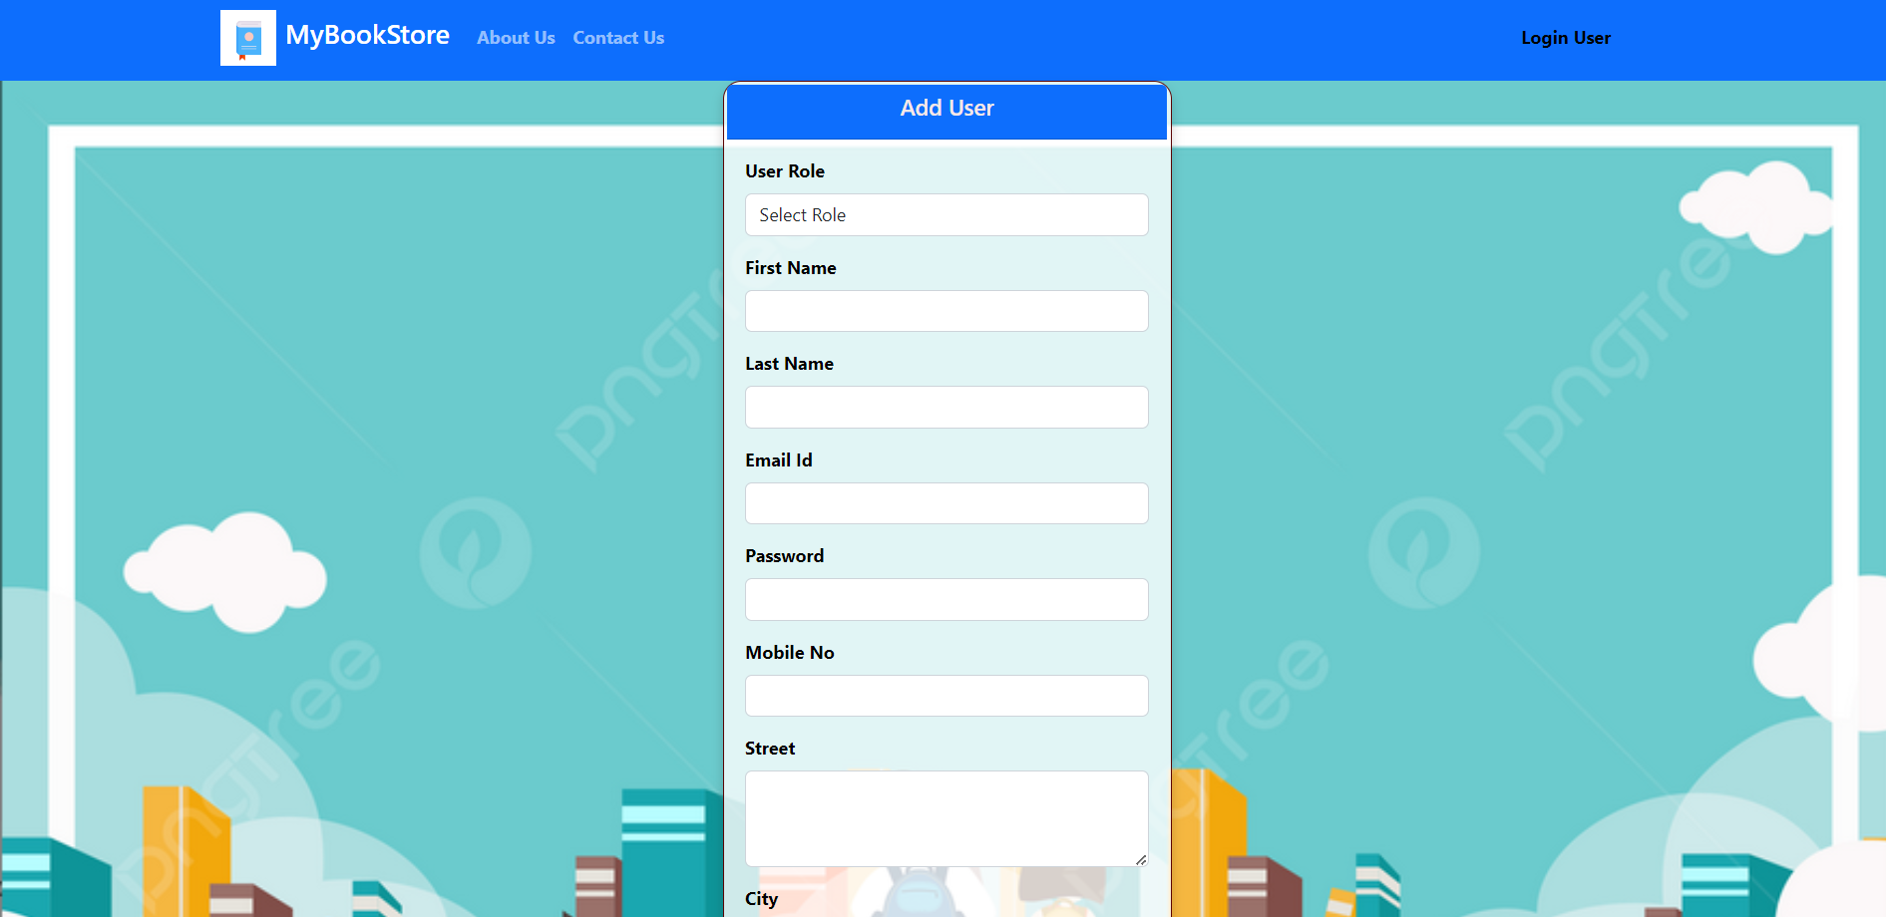
Registration Window

Slide 18
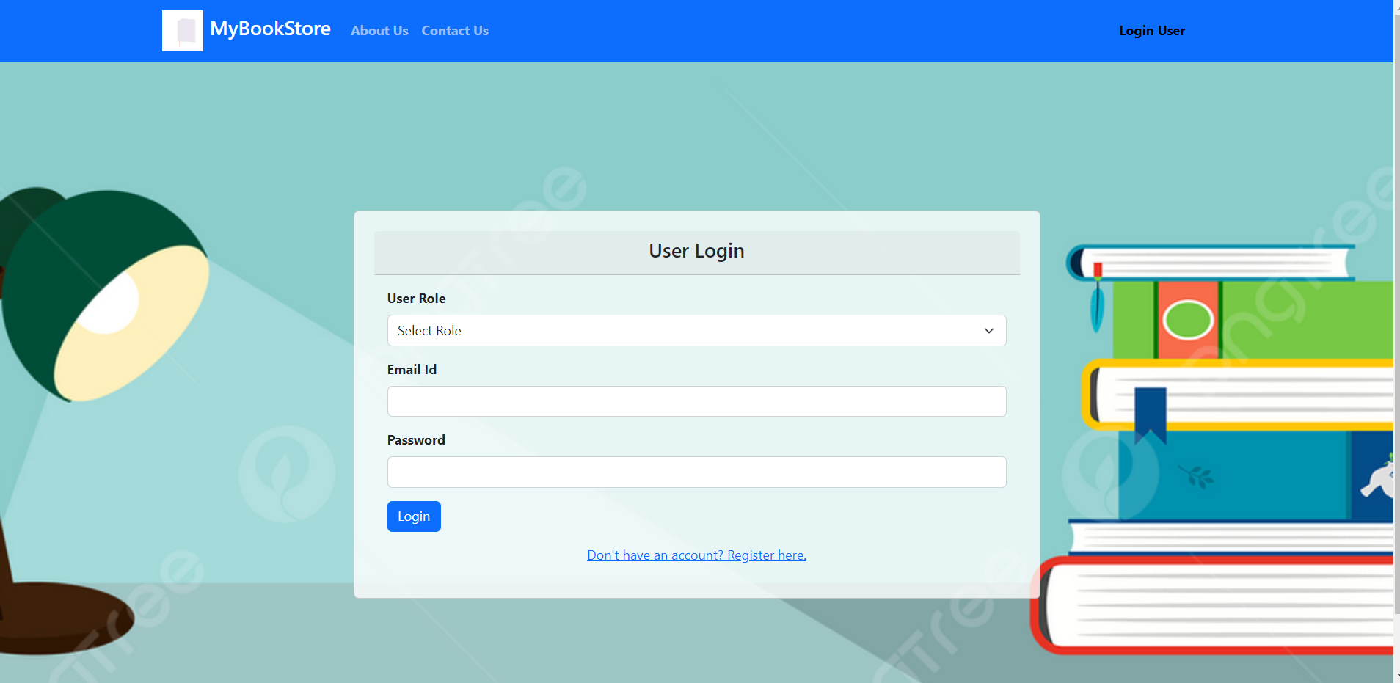
Login Window

Slide 19
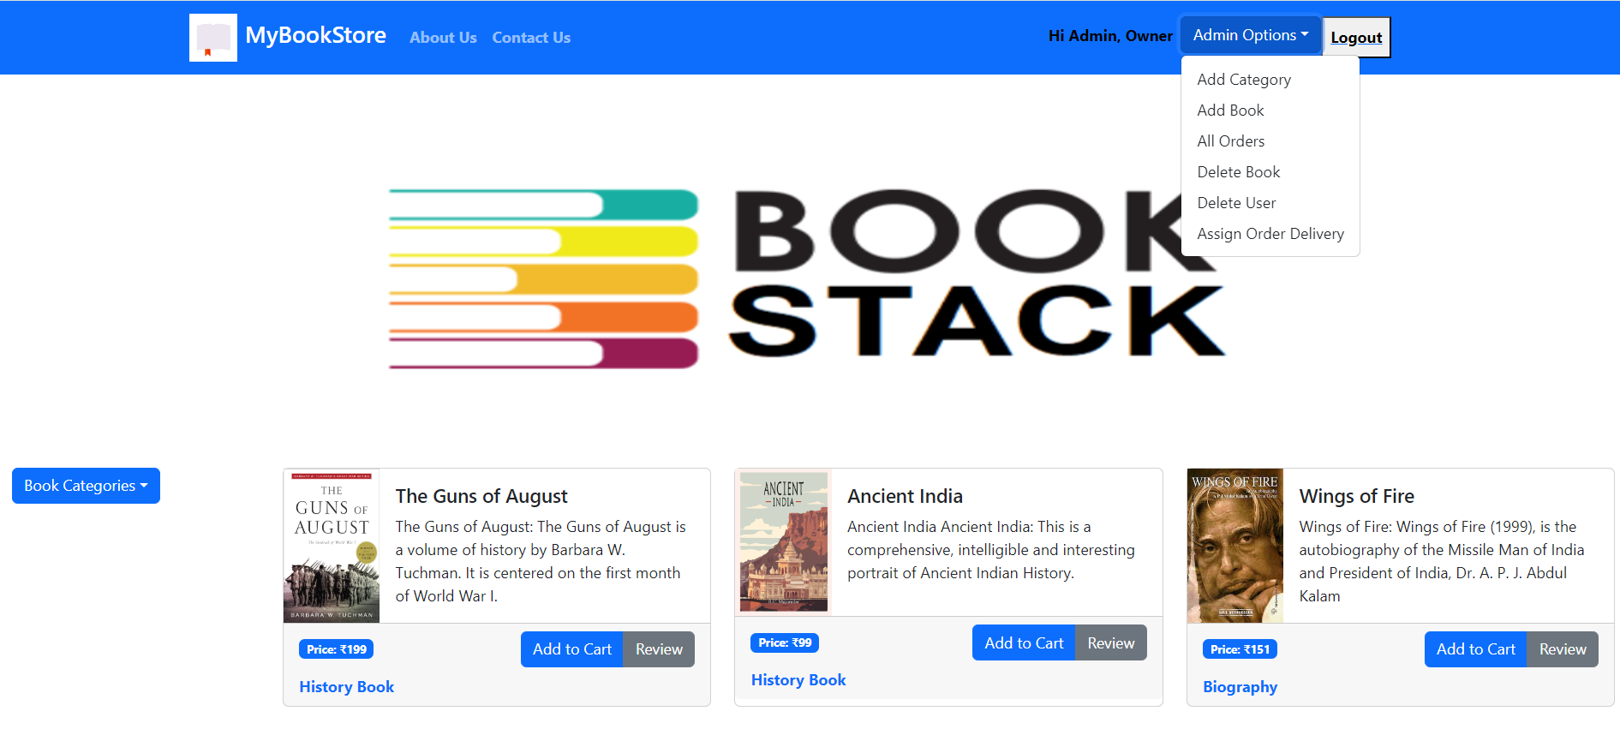
Admin Front Page

Slide 20
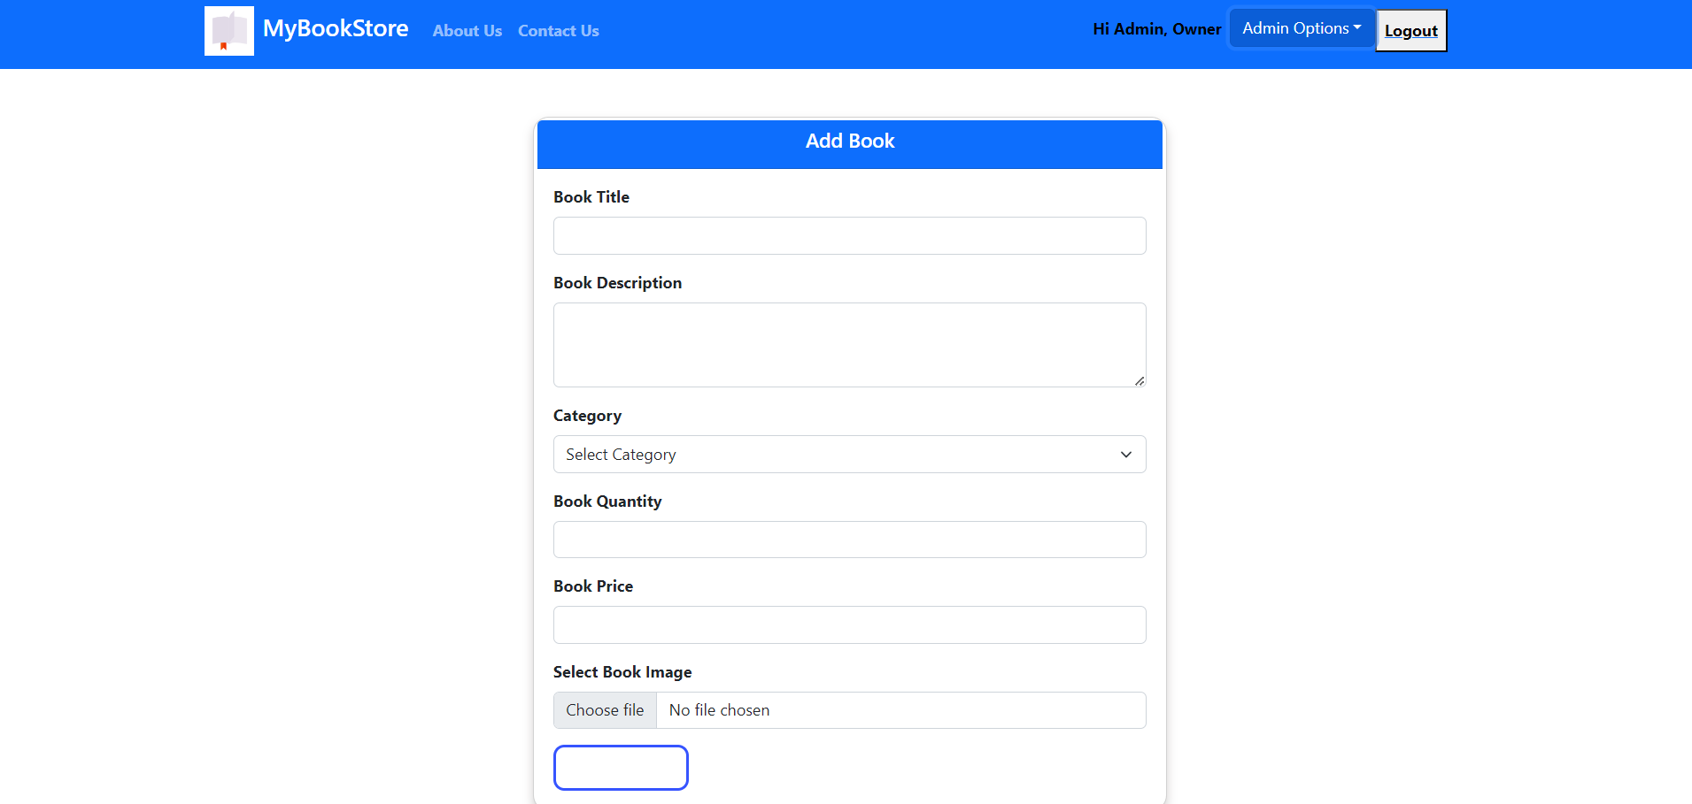
Admin Add Book

Slide 21
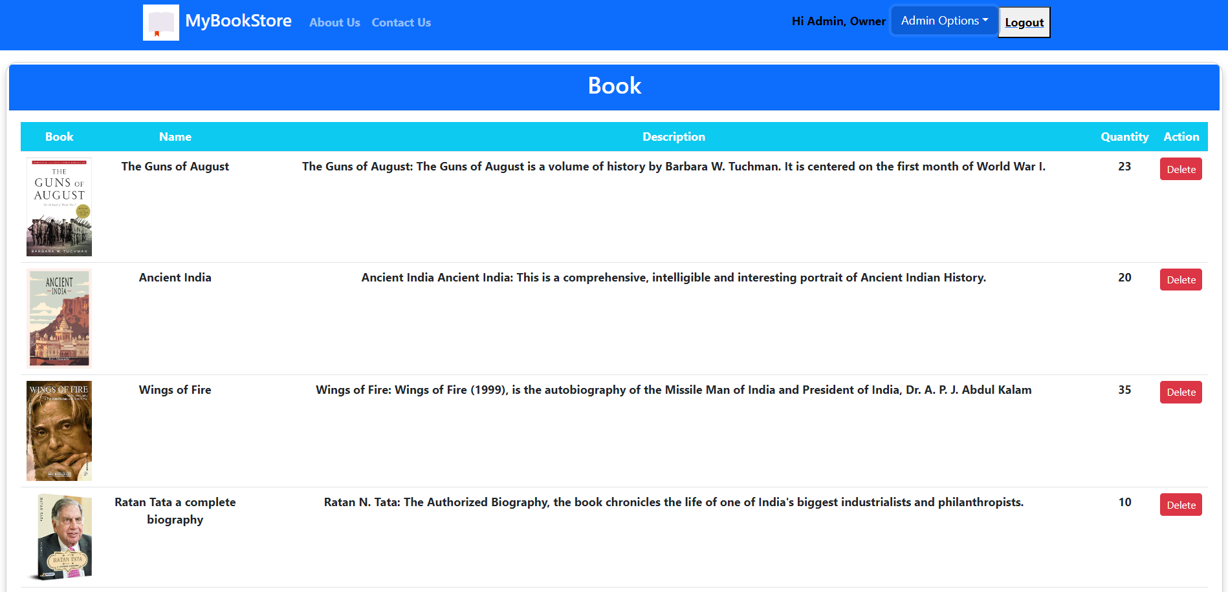
Admin delete book

Slide 22
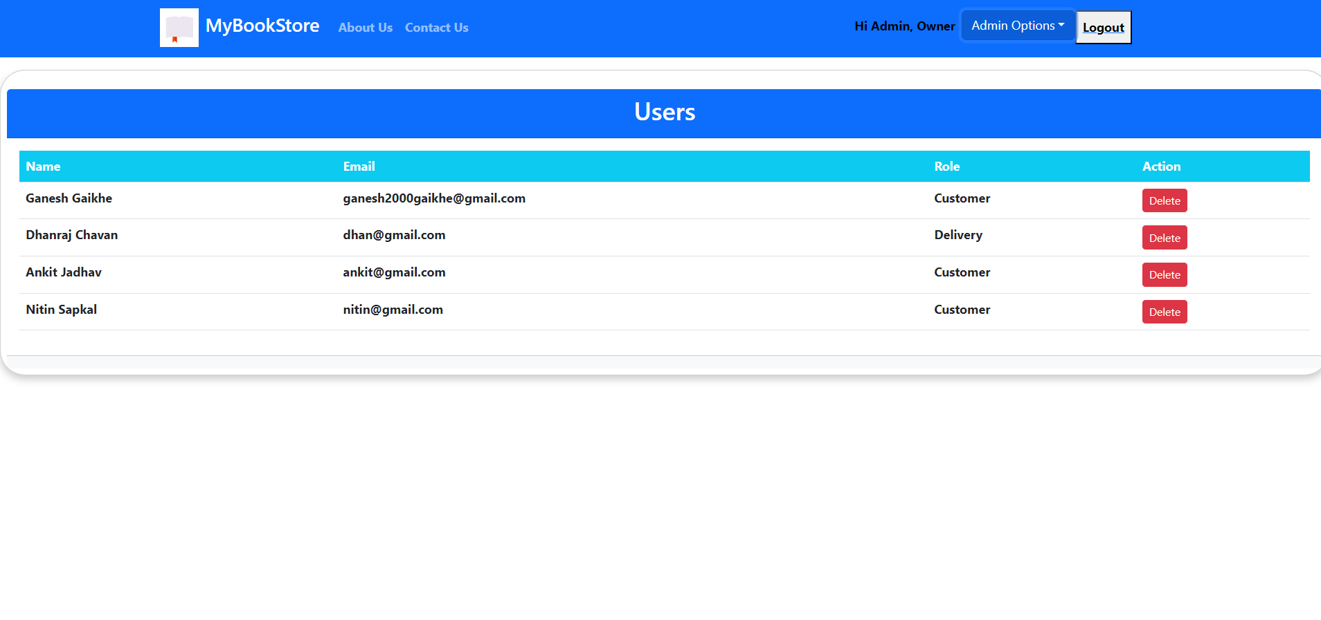
Delete User by admin

Slide 23
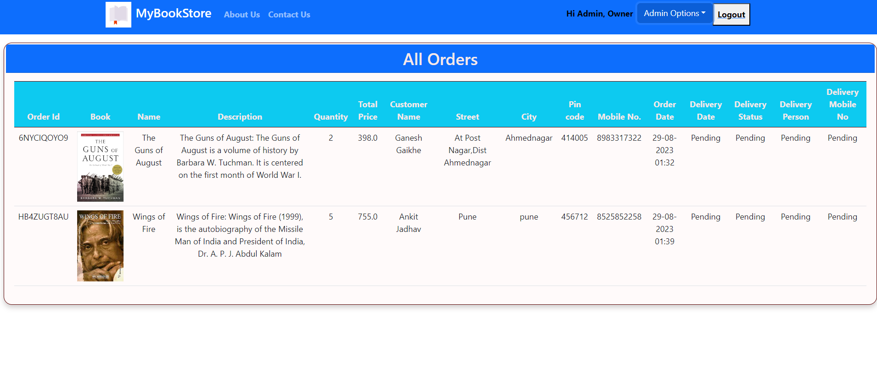
All Orders Seen By Admin

Slide 24
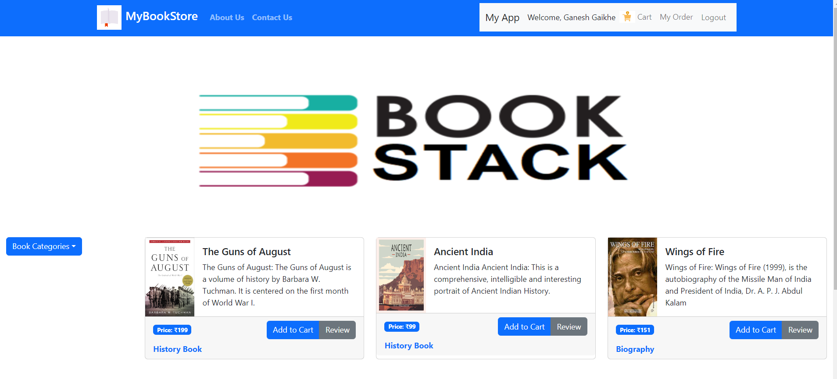
Front Page Of Register Customer

Slide 25
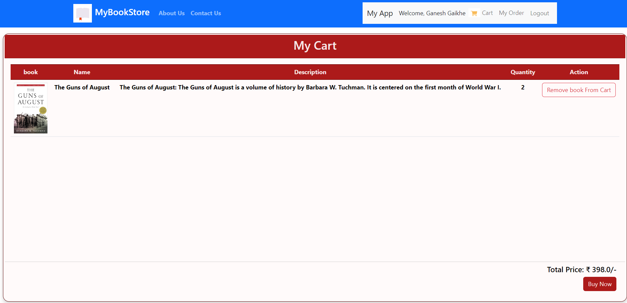
Cart Of Customer

Slide 26
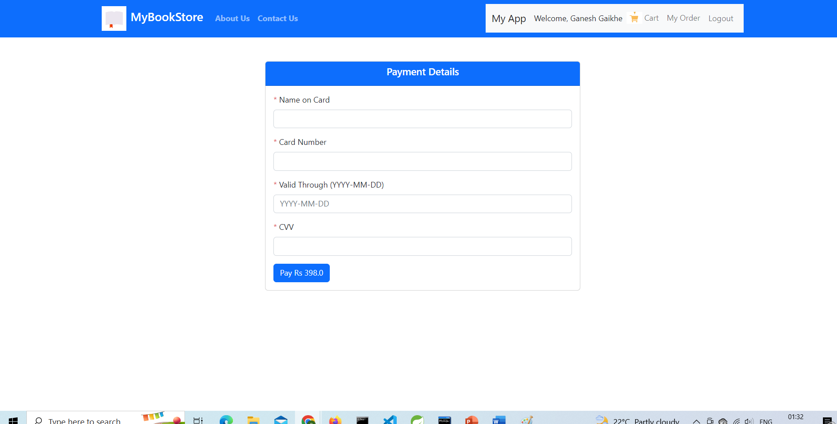
Payment Window Under Customer

Slide 27
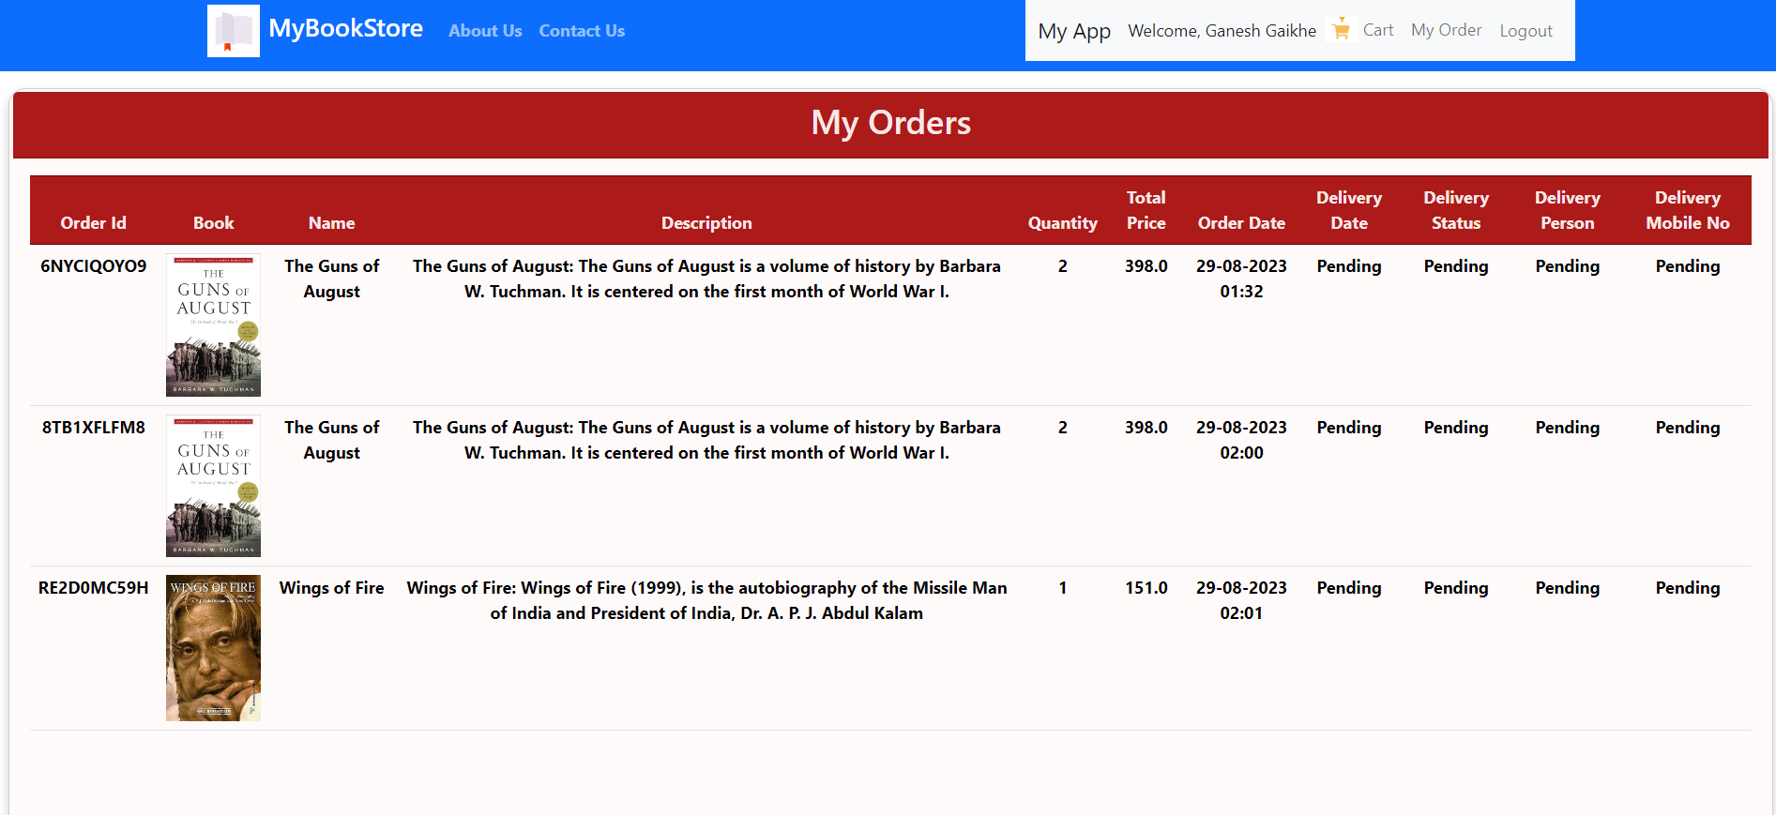
Orders of Customer

Slide 28
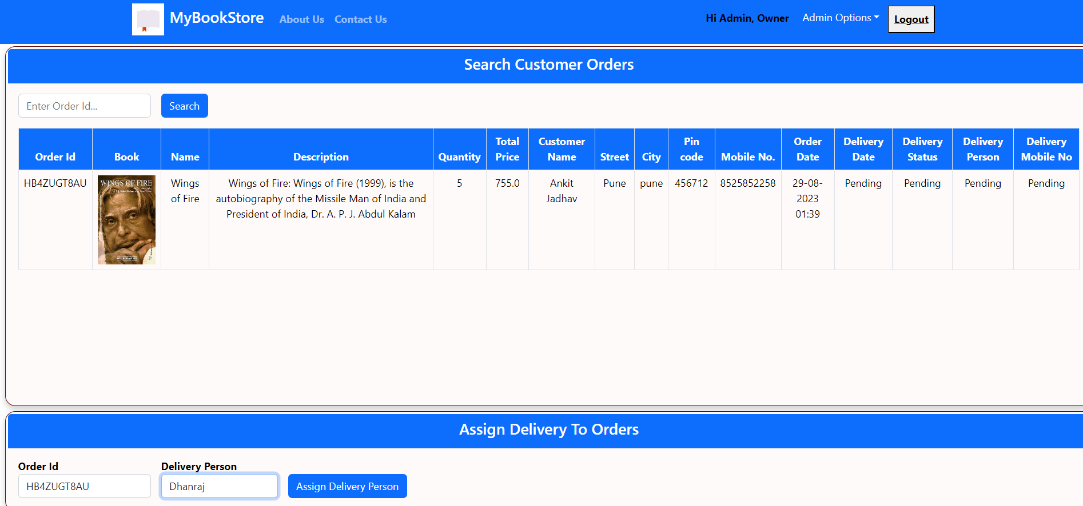
Assign Delivery Person By Admin

Slide 29
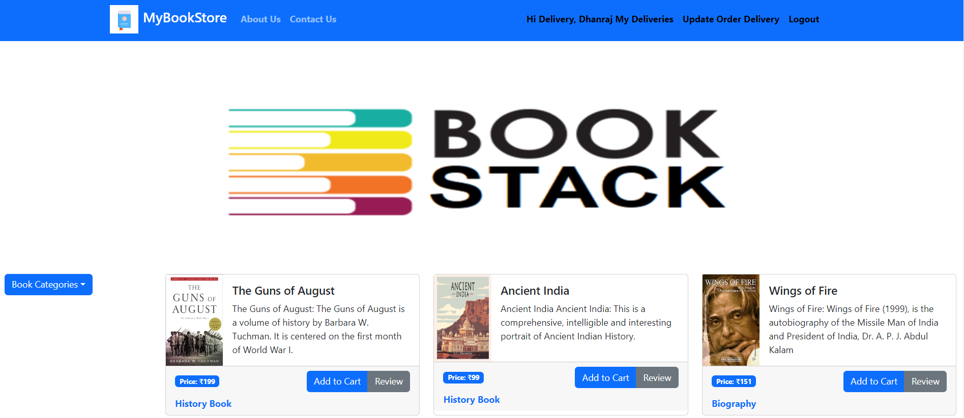
Front Page Of Delivery Person

Slide 30
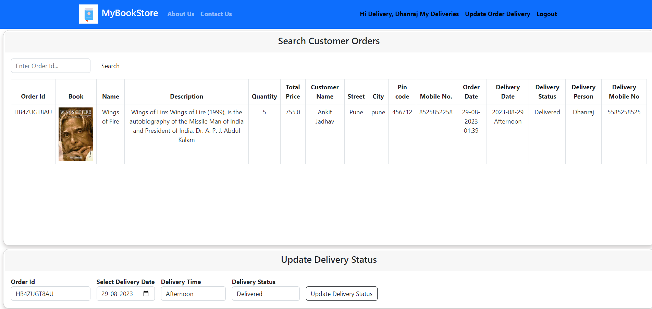
Update Delivery Status By Delivery Person

Slide 31
Reference
React – A JavaScript library for building user interfaces (reactjs.org)
Bootstrap · The most popular HTML, CSS, and JS library in the world. (getbootstrap.com)
React Tutorial (w3schools.com)
Java 11 api docs
Spring Data JPA - Reference Documentation

Slide 32
THANK YOU

